Slide 1
DENGUE
Dr. Dinesh. K

Slide 2
DENGUE
Mosquito-borne viral disease
Flaviviridae family – Serotypes includes DENV-1, DENV-2, DENV-3 and DENV-4
Transmitted by female mosquitoes mainly of the species Aedes aegypti
Ranges from subclinical disease to severe flu-like symptoms
Rarely, people develop severe dengue
At risk population is about 50% of world [ 70% in Asia ]

Slide 3
FACTORS – DENGUE RISE
↑ Vector transmission
Climate change
Increase in air travel
Improper H₂O storage
Population growth
Unplanned urbanisation

Slide 4
TRANSMISSION
Mosquito-to-human
Extrinsic incubation period (EIP). The EIP takes about 8-12 days
Intrinsic incubation period ranges from 3-14 day
Ambient temperature is between 25-28°C
Trans-ovarial infection present
A.aegypti brreds in stagnant clear water sources
Feeds in dawn and dusk timings

Slide 5
TRANSMISSION
Human-to-mosquito transmission
Can occur 2 days before someone shows symptoms of the illness , up to 2 days after the fever has resolved
Risk of mosquito infection is positively associated with high viremia and high fever
Viremia lasts for about 4-5 days, but viremia can last as long as 12 days
Materno-Fetal - pre-term birth, low birthweight, and fetal distress

Slide 6
DENGUE - PATHOGENESIS
Immune mediated damage
DENV specific T cells appear protective
Cytokine storm heralds onset of vascular leakage
Dendritic cells, monocytes, macrophages – predominant sources of cytokines
Target for vascular leakage – postcapillary venules

Slide 7
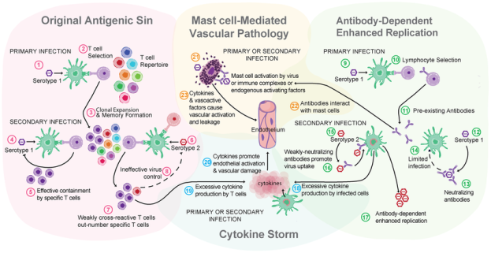
PATHOGENESIS

Slide 8
DENGUE - PATHOGENESIS
Dengue 2 & 3 causes severe disease frequently
Higher levels of NS1Ag correlates to rusk of DHF
NS1Ag activates complement which complex with Ag-Ab units

Slide 9
CLINICAL PHASES
FEBRILE PHASE ( 5-8 DAYS)
CRITICAL / LEAKAGE PHASE (48-72 HOURS)
RECOVERY PHASE

Slide 10
FEBRILE PHASE
Lasts 2-7 days
facial flushing, skin erythema, generalised body ache, myalgia, arthralgia and headache can be seen
Positive tourniquet test in this phase increases the probability of dengue
Mild haemorrhagic manifestations like petechiae and mucosal membrane bleeding (e.g. nose and gums) may be seen
Progressive decrease in total white cell count is earliest lab finding

Slide 11
CRITICAL PHASE
Progressive leukopenia followed by a rapid decrease in platelet count usually precedes plasma leakage
Period of clinically significant plasma leakage usually lasts 24–48 hours
Pleural effusion and ascites may be clinically detectable
Shock occurs when a critical volume of plasma is lost through leakage
Diastolic BP rises causing narrow pulse BP initially , prior to hypotensive shock

Slide 12
RECOVERY PHASE
Extravascular compartment fluid takes place in the following 48–72 hours
General well-being improves, appetite returns, gastrointestinal symptoms abate, haemodynamic status stabilizes and diuresis ensues
Generalized pruritus with recovery rash may be seen
Respiratory distress from massive pleural effusion and ascites will occur at any time if excessive intravenous fluids have been administered

Slide 13
SEVERE DENGUE
Initial stage of shock, the compensatory mechanism which maintains a normal systolic blood pressure also produces tachycardia and peripheral vasoconstriction
Diastolic pressure rises towards the systolic pressure and the pulse pressure narrows
Finally, there is decompensation and both pressures disappear abruptly
Prolonged hypotensive shock and hypoxia may lead to multi-organ failure
Major bleeding almost always associated with profound shock since this, in combination with thrombocytopaenia, hypoxia and acidosis, can lead to multiple organ failure and advanced disseminated intravascular coagulation

Slide 15
INVESTIGATIONS
VIROLOGICAL –
RT-PCR ( costly )
NS1Ag ELISA
SEROLOGICAL
IgM ELISA
IgM antibodies are detectable ~1 week after infection and are highest at 2 to 4 weeks after the onset of illness

Slide 16
INVESTIGATIONS
CBC – Hb , PCV, plt
LFT
RFT
RBS
CXR
USG- abdomen
PT-INR, aPTT

Slide 17
TREATMENT
No specific treatment for dengue fever
Paracetamol for fever
Fluids administration depending upon clinical phase

Slide 18
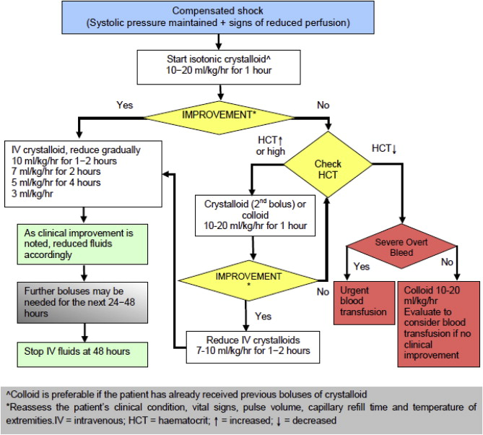

Slide 19
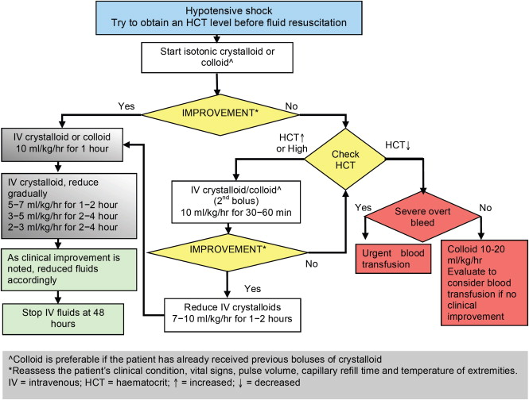

Slide 20
Platelets in Dengue
Bone marrow depression
Increased apoptosis stimulated by DENV
Platelet antibodies
Thrombasthenia

Slide 21
DENGUE VACCINE
PHASE 3 HUMAN trials
All 4 DENV strains
3 dose regimen
Found more effective in children

Slide 22
THANK YOU

